Slide 1
Magnetically Enhanced Microflow Cytometer for Bead-based Immunoaffinity Measurements in Blood Samples
Master Thesis Presentation
Johann A. Brenner
Munich, 29.03.2021

Slide 2
Outline
Theory
Immuno-Affinity Measurements in the Magnetic Flow Cytometer
Surface Chemistry Methods
Results
Simulation
Virtual Prototyping of Cell Signals
Calculus Estimation of the Force-Equilibrium in a Microchannel
Experimental
Magnetic Concentration Measurements
Development of a Differential Counting Setup
Established Reference Model for Surface Marker Expression Densities
Affinity-based Concentration Measurements in the Magnetic Flow Cytometer
Conclusion

Slide 3
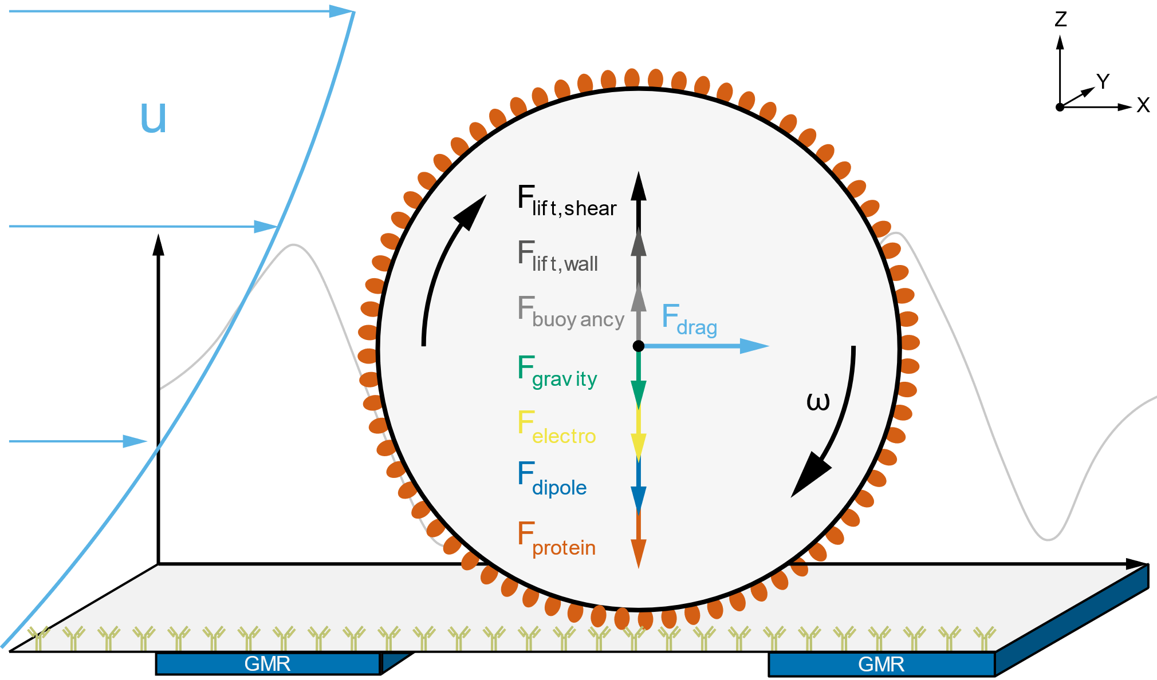
Theory
Immuno-Affinity Measurements in the Magnetic Flow Cytometer
Magnetic bead rolling on the floor of a microchannel
Biofunctionalized Channel
Force-Equilibrium:
Hydrodynamics
Volume Forces
Electro-Magnetism
➔ Change in Velocity or Adhesion

Slide 4
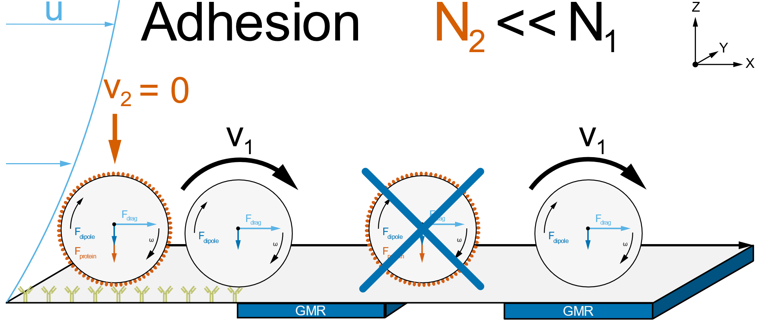
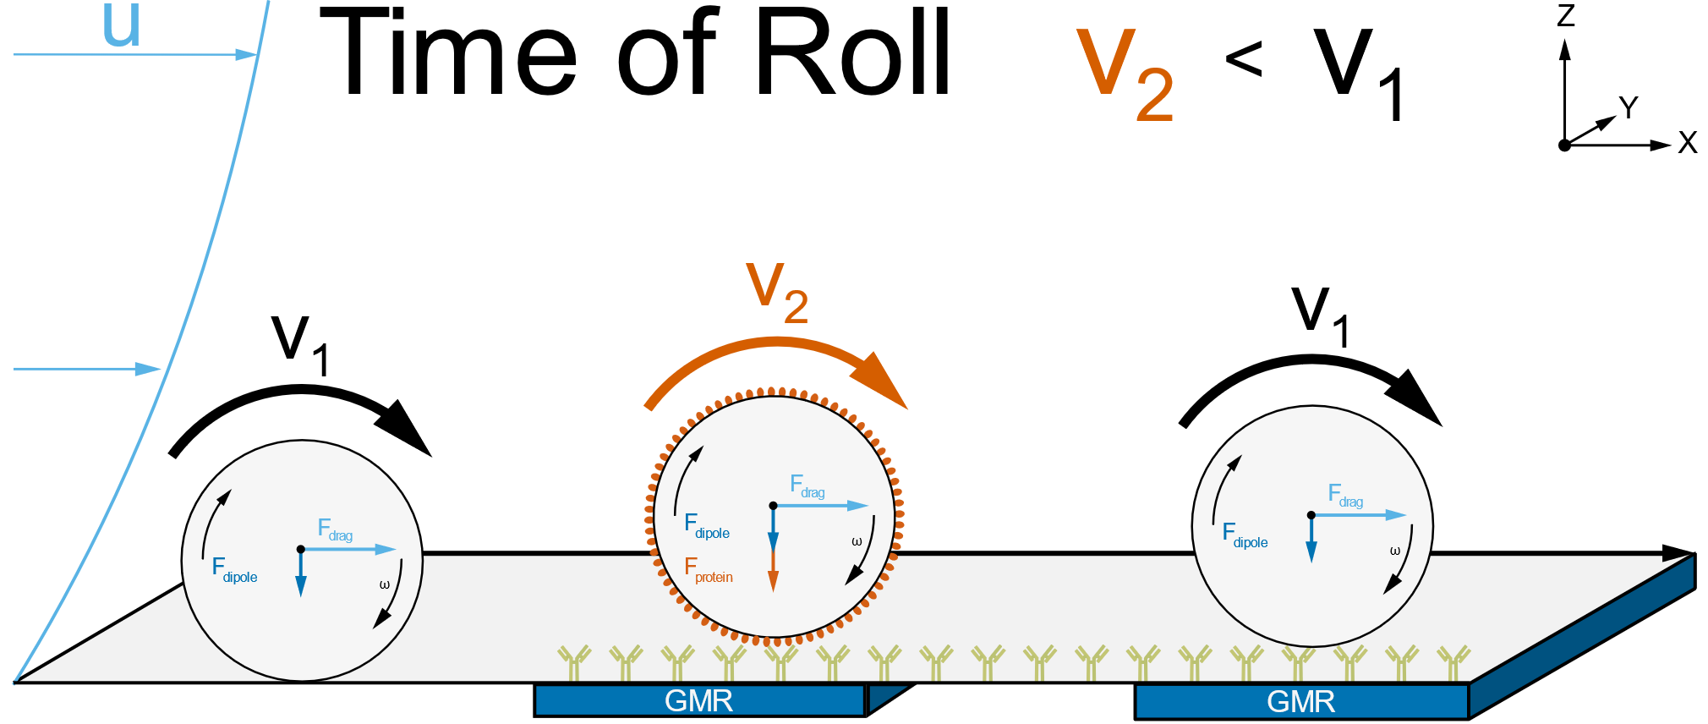
Theory
Immuno-Affinity Measurements in the Magnetic Flow Cytometer

Slide 5
Theory
Immuno-Affinity Measurements in the Magnetic Flow Cytometer

Slide 6
Theory
Immuno-Affinity Measurements in the Magnetic Flow Cytometer

Slide 7
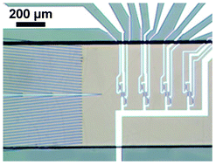
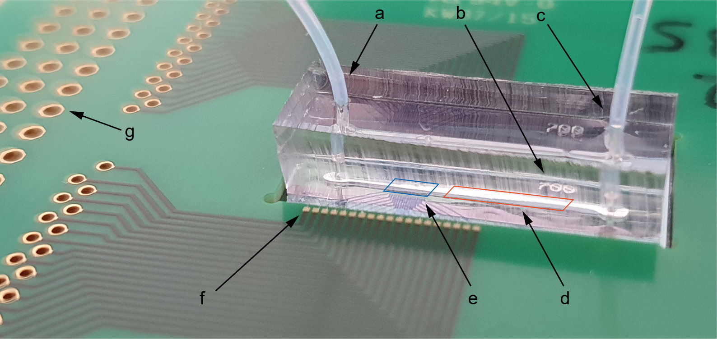
Theory
Immuno-Affinity Measurements in the Magnetic Flow Cytometer
2.5 mm
Helou et al. (2013) Lab on a Chip, 13(6)

Slide 8
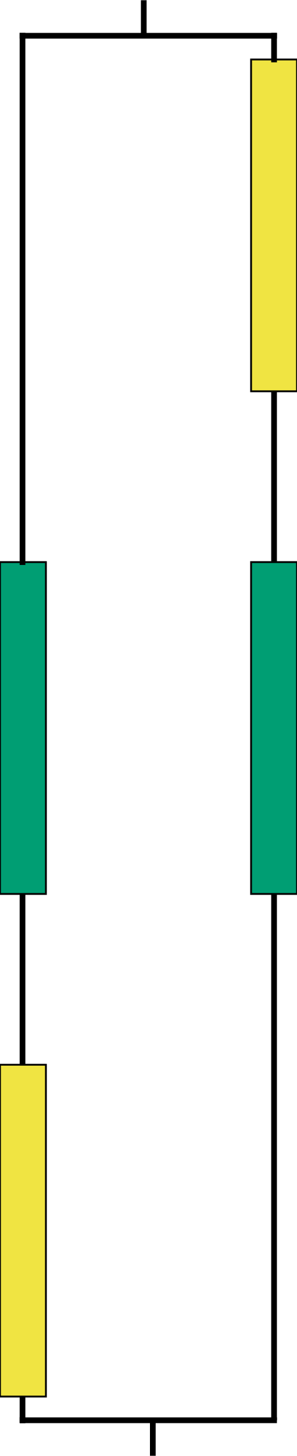
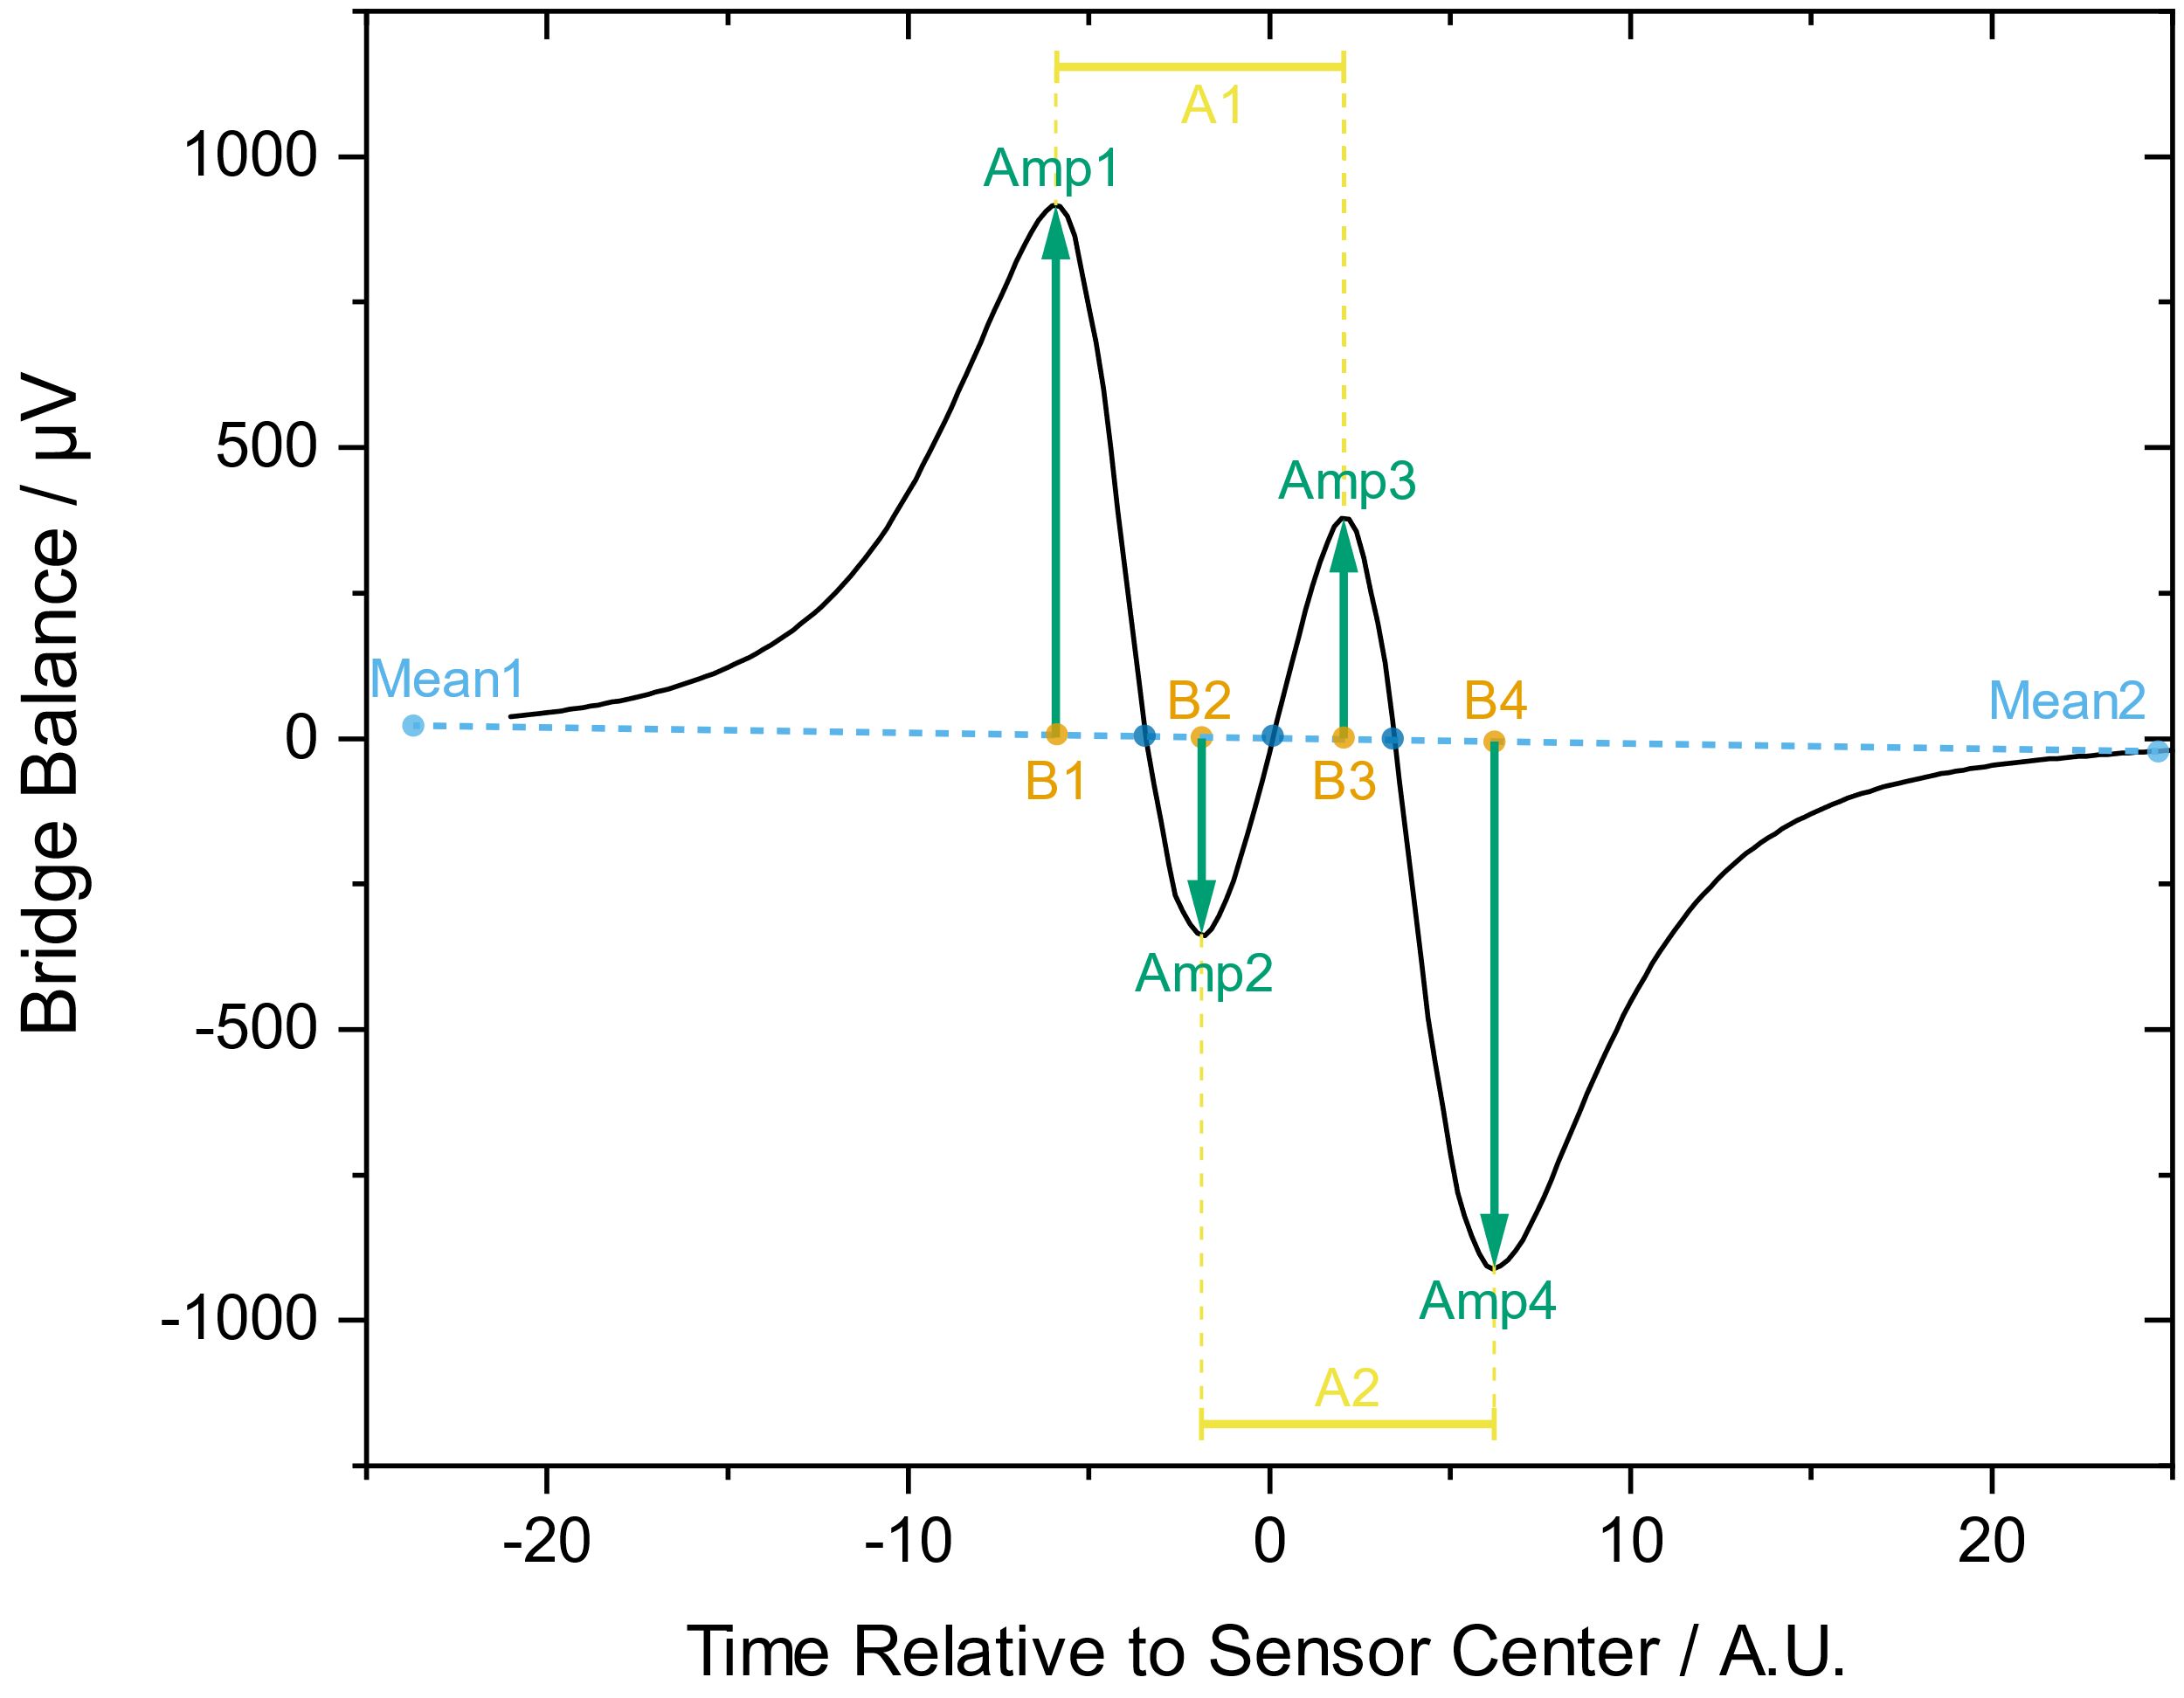
Theory
Immuno-Affinity Measurements in the Magnetic Flow Cytometer

Slide 9
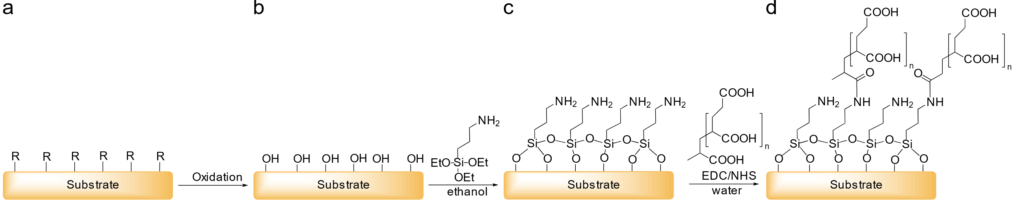
Theory
Surface Chemistry Methods – Covalent Modification
Oxidation
Silanization
Polymer Coating
Protein
Attachment

Slide 10
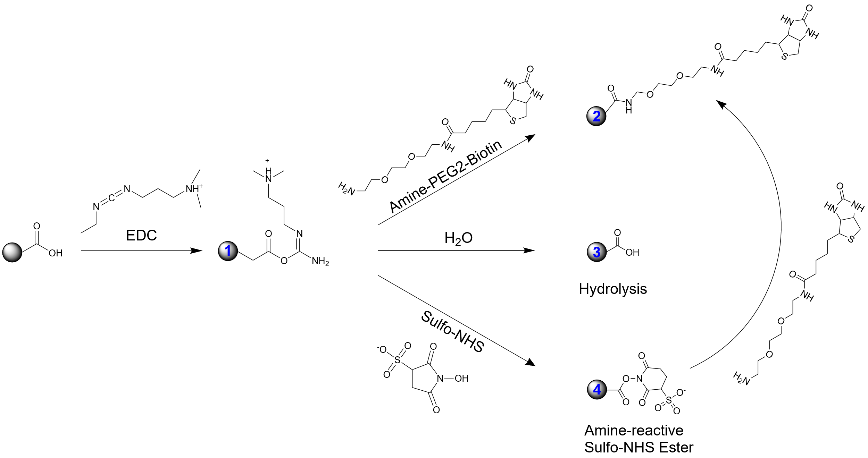
Theory
Surface Chemistry Methods – Particles

Slide 11
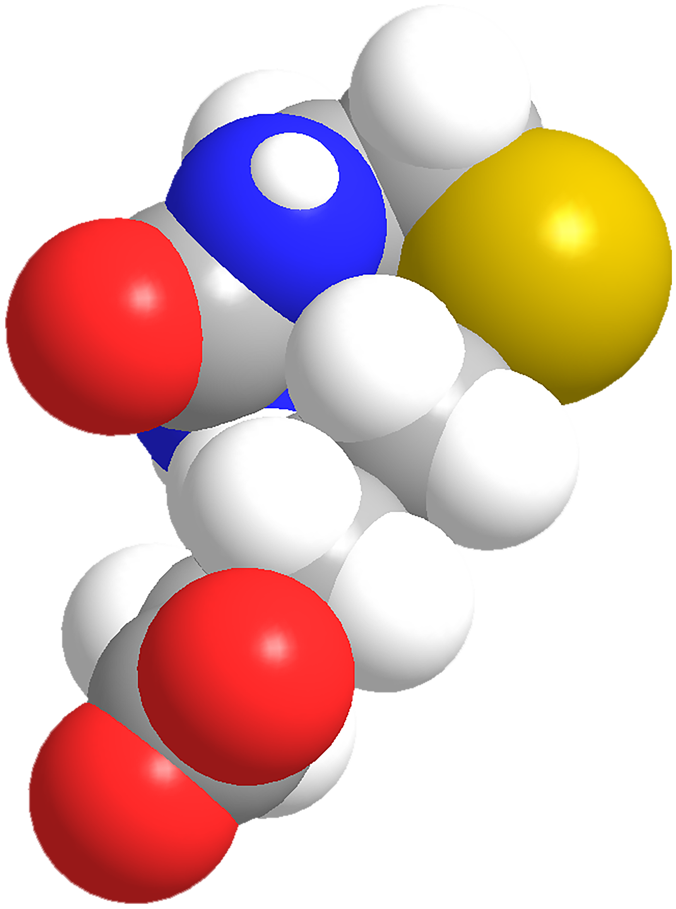
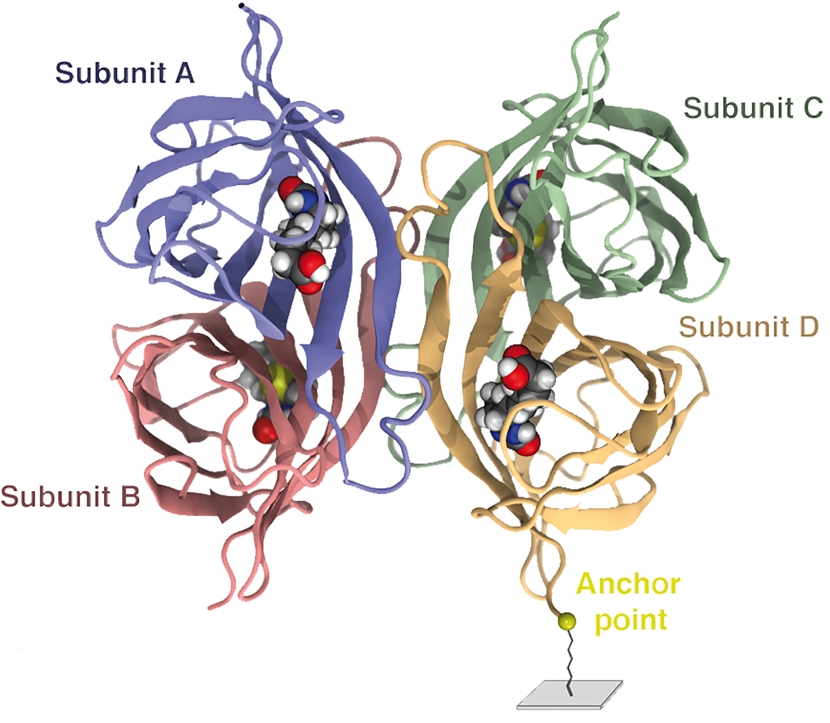
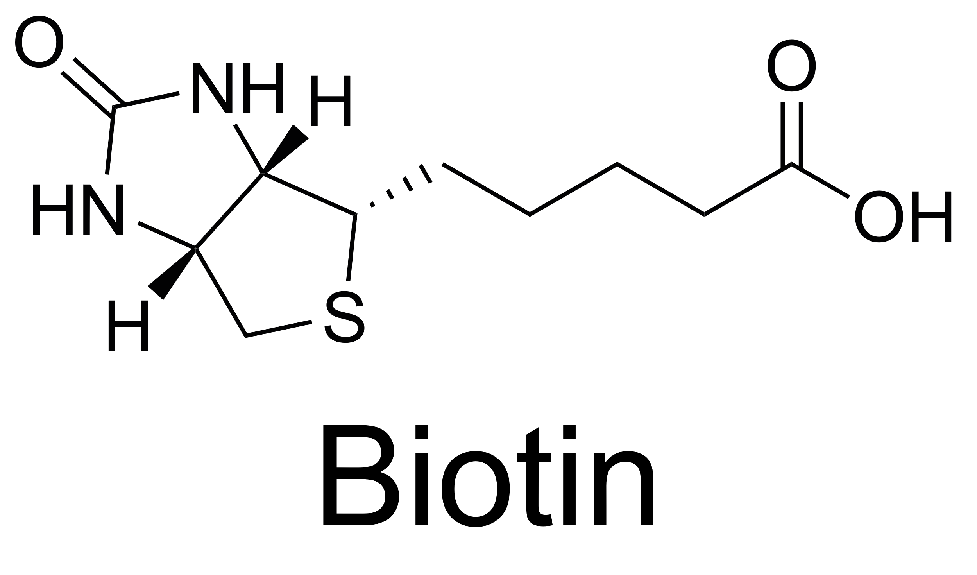
Theory
Surface Chemistry Methods – Biotin-Streptavidin
Biotin-Streptavidin Interaction
One of the strongest known non-covalent bonds
Affinity: 10⁻¹³ - 10⁻¹⁵
Release force: 100 – 400 pN
Adhesion
Sedlak et al. (2020) Sci Adv, 6(13)

Slide 12
Theory
Surface Chemistry Methods – Biotin-Streptavidin

Slide 13
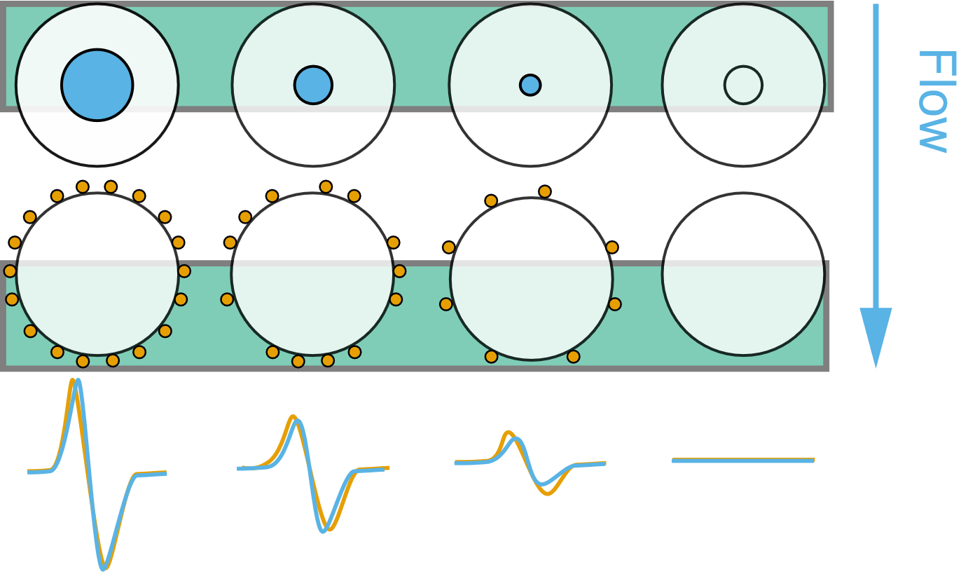
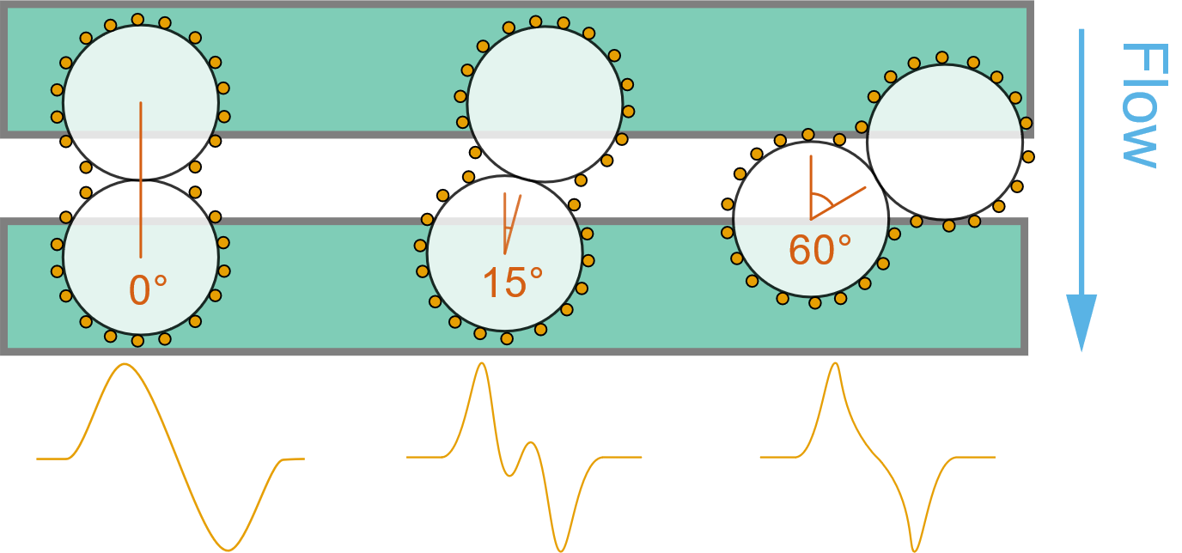
Results
Simulation – Virtual Prototyping of Cell Signals
MNP-Coverage Evaluation
Aggregate Angle Evaluation
Notes:
Simulation of cells which are labelled magnetically and flowing over the sensor bridge
Epitope density should be modelled
Left: Signal dependency of coverage
Compared to a reference dipole indicated by the blue circles → if all momentum is located in the center
Right: Influence of cell aggregates on the signal shape and their deviation from the reference dipole

Slide 14
Results
Simulation – Virtual Prototyping of Cell Signals
Low Coverage:
Single Magnetic Momenta cause field inhomogenity
Signal deterioration for larger cell diameters
Notes:
641 600 MNP with 20 nm
81 MNP with 2 μm
Left:
Low Coverage:
Single Magnetic Momenta cause field inhomogenity
magnetic momentum per MNP as it is dependent on the volume - thus r3.
Larger Particles cause more likely inhomogeneities
Right:
Maximum correlation shows also a significant deterioration for larger cell diameter
It is assumed, that the correlation error becomes constant at great Particles

Slide 15
Results
Simulation – Virtual Prototyping of Cell Signals

Slide 16
Results
Simulation – Virtual Prototyping of Cell Signals
High correlation in the medium coverage regime due to inhomgeneous field
Low yaw and high coverage → Two dipoles in superposition
High yaw and coverage → Aggregate cannot be discriminated by the sensor
Notes:
two 200 nm MNP-covered cells
Interestingly the error for 15° and 30° is largest
Low coverage: Field inhomogeneous, but not influenced by two spheres
For low yaw angle and high coverages
the aggregate’s signal reflects rather two single dipoles in superposition than one quite homogeneous dipole.
High yaw angle, and high coverages:
Two beads parallel to the large sensor side cannot be discriminated → similar correlation

Slide 17
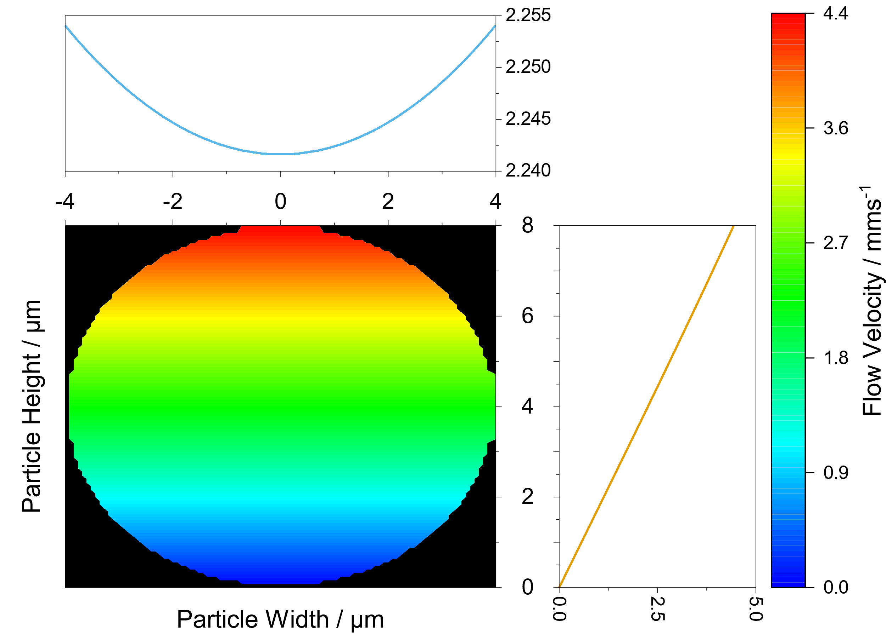
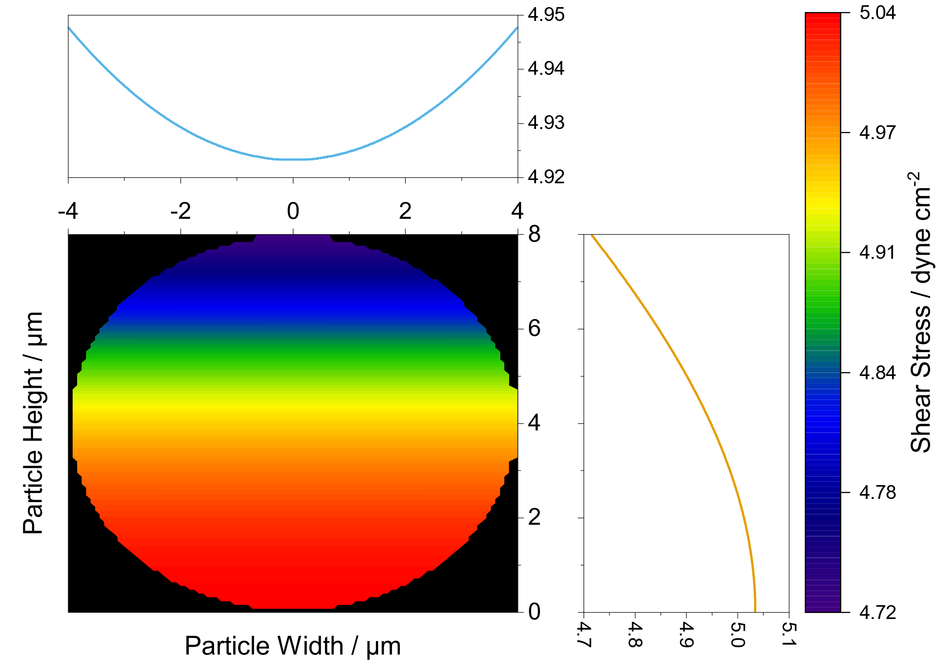
Results
Simulation – Calculus Estimation of the Force-Equilibrium in a Microchannel
Flow Field in a Particle
Shear Field in a Particle
Notes:
Framework has been developed to analyze the force equilibrium inside the channel and on the rolling bead
Flow induces rolling motion → Top is actuated more
However, high shear acts at the wall and thus the potential biological bonds.

Slide 18
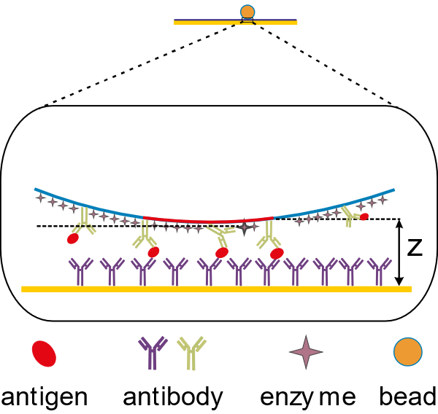
Results
Simulation – Calculus Estimation of the Force-Equilibrium in a Microchannel

Slide 19
Results
Experimental – Magnetic Concentration Measurements

Slide 21
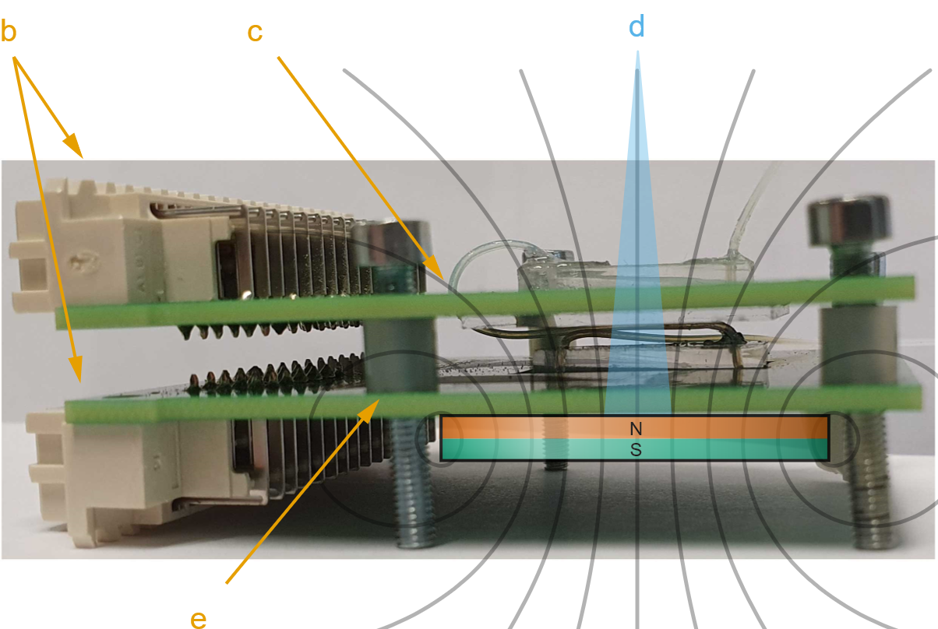
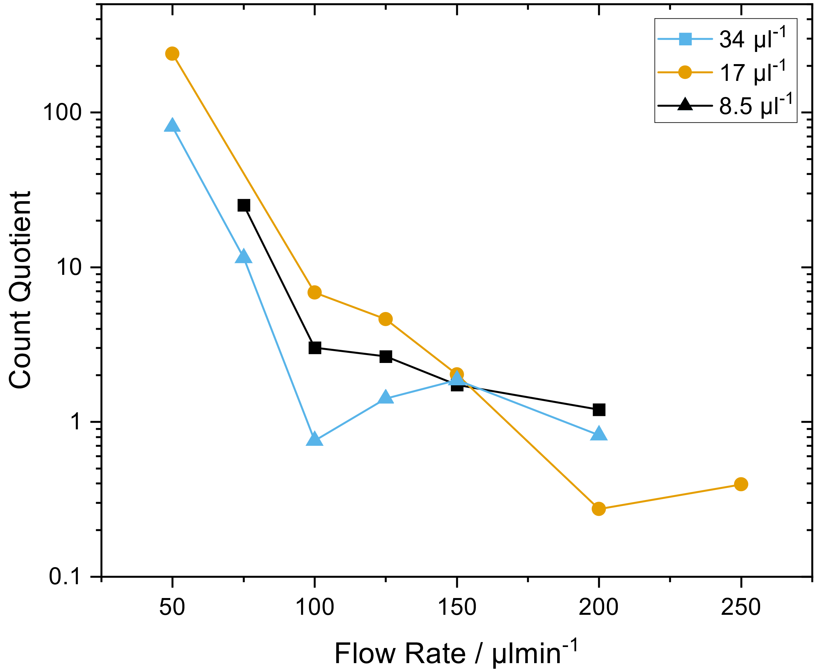
Results
Experimental – Development of a Differential Counting Setup

Slide 22
Results
Experimental – Development of a Differential Counting Setup

Slide 23
Results
Experimental – Established Reference Model for Surface Marker Expression Densities

Slide 25
Results
Experimental – Established Reference Model for Surface Marker Expression Densities
Ocean Nanotech MNPs

Slide 26
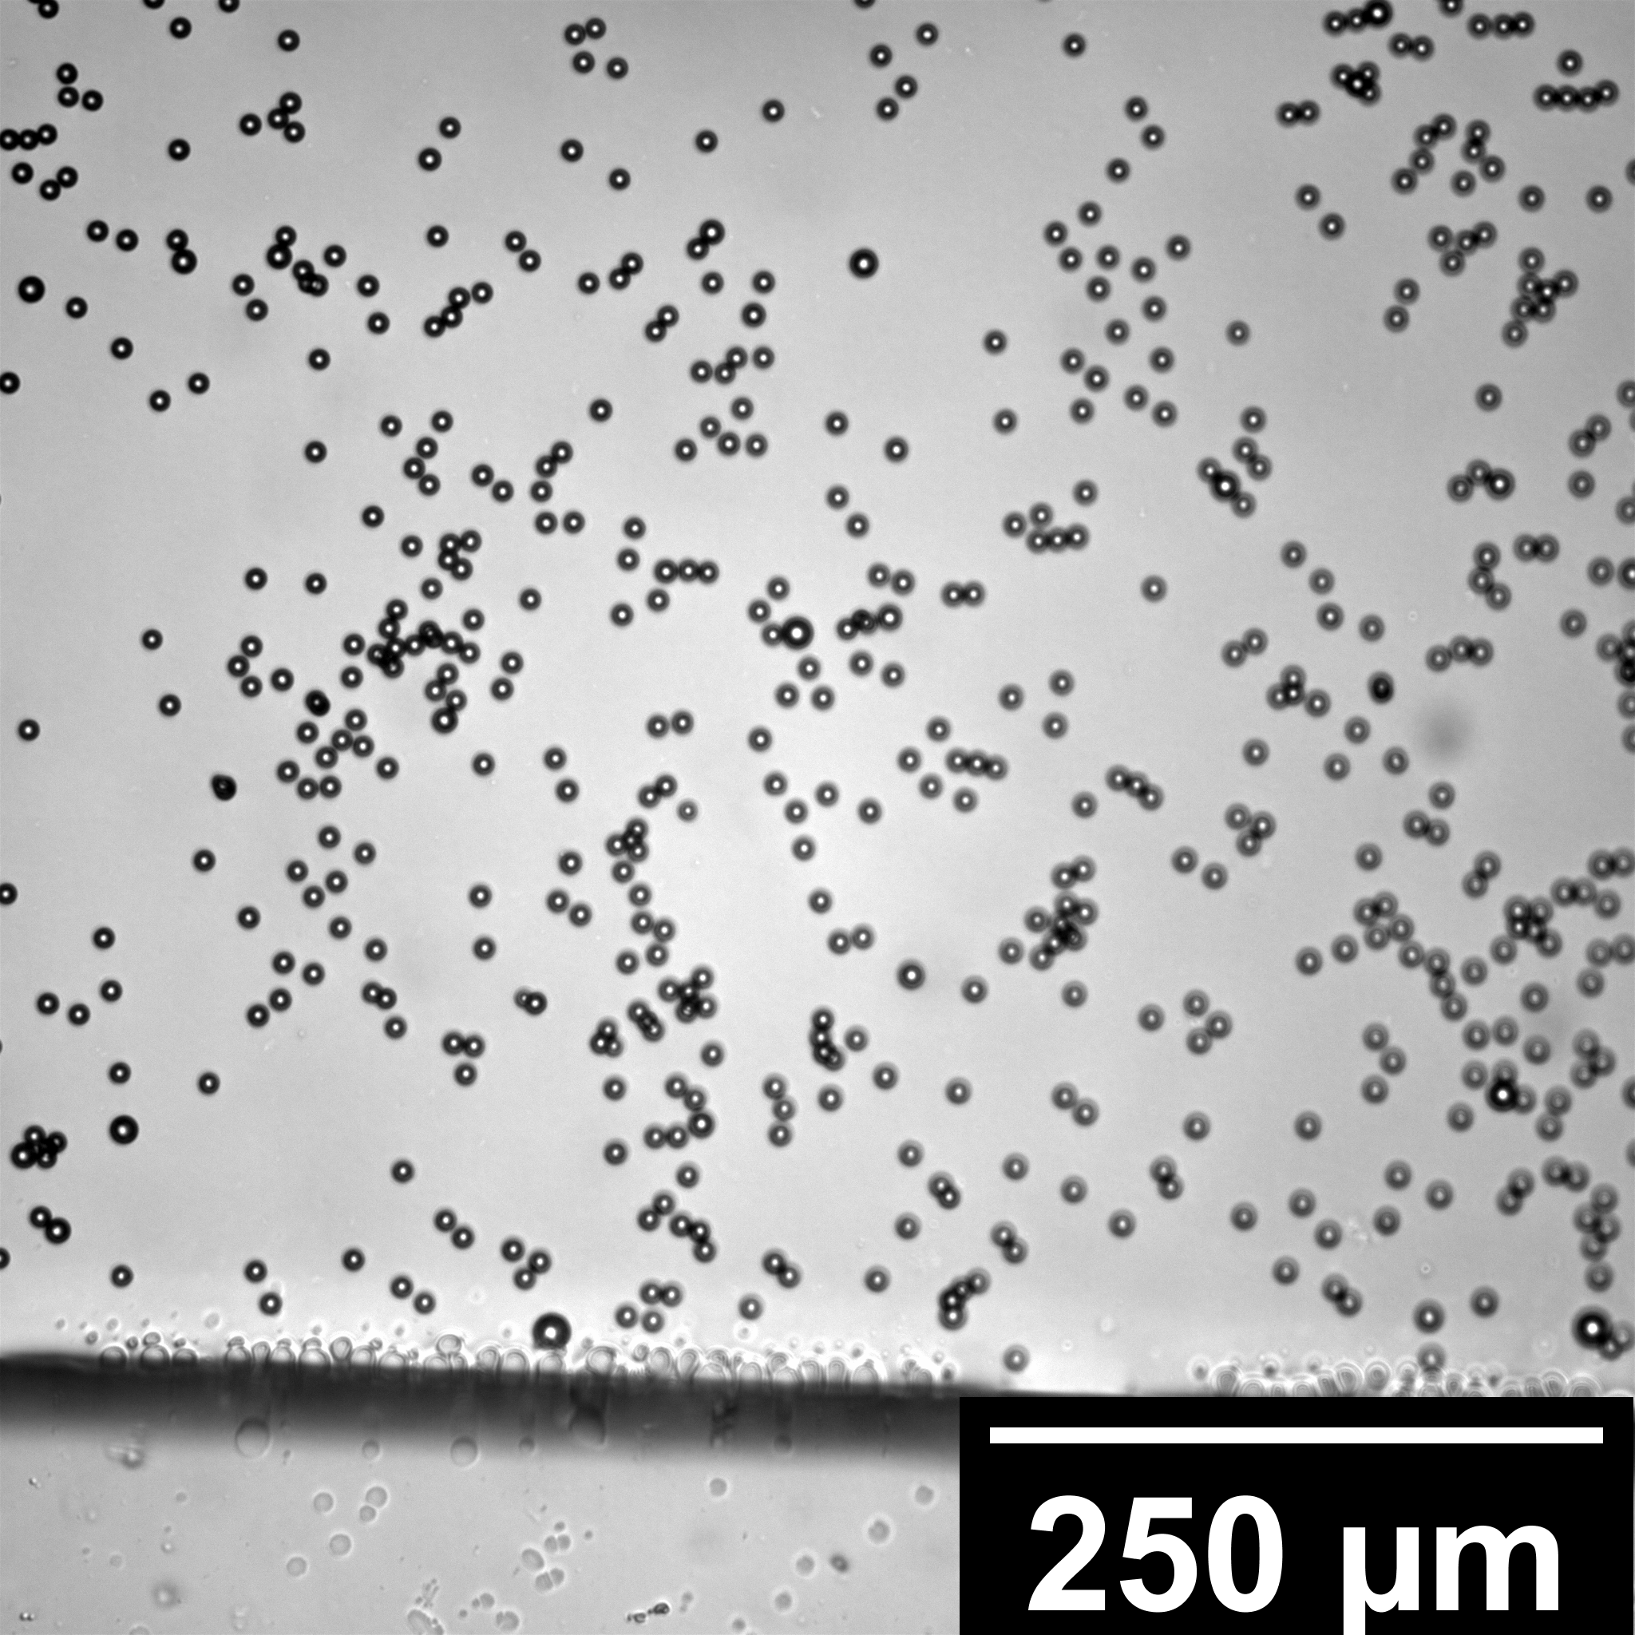
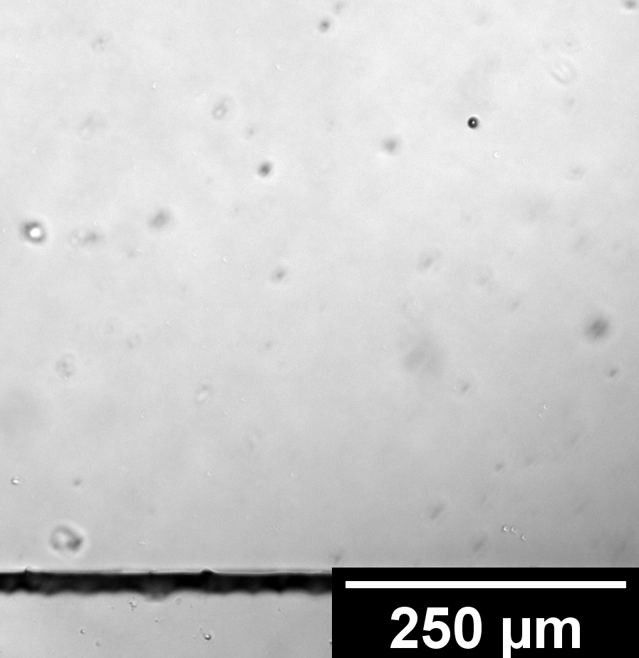
Results
Experimental – Affinity-based Concentration Measurements in the Magnetic Flow Cytometer

Slide 27
Results
Experimental – Affinity-based Concentration Measurements in the
Magnetic Flow Cytometer

Slide 28
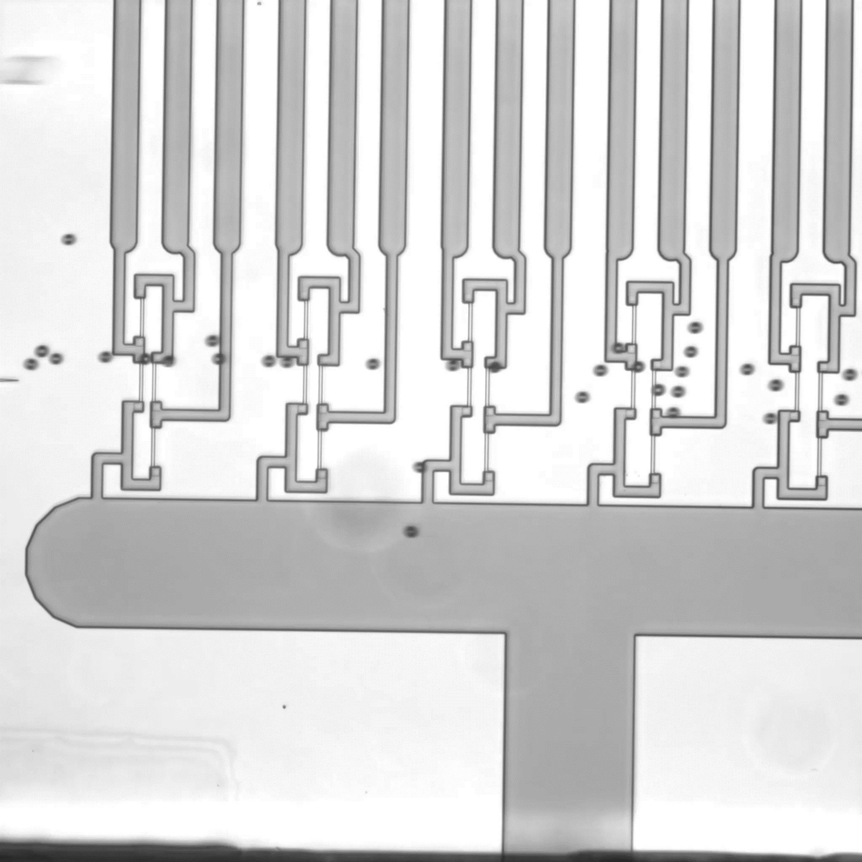
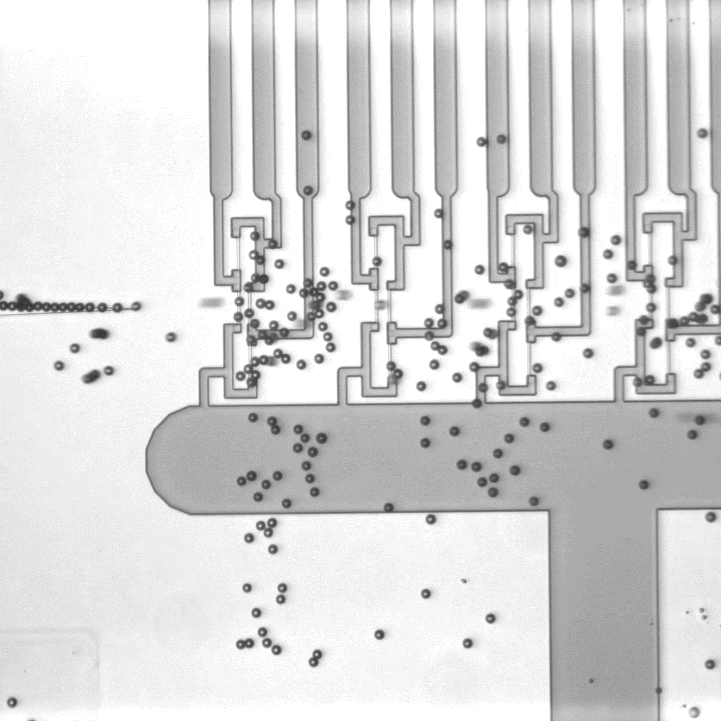
Plain Particles
Biotinylated Particles

Slide 29
Results
Experimental – Affinity-based Concentration Measurements in the Magnetic Flow Cytometer

Slide 30
Conclusion

Slide 31
Thank you!

Slide 32
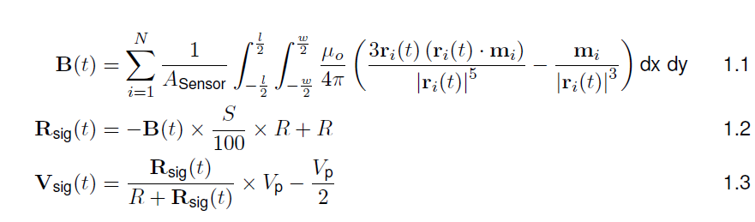
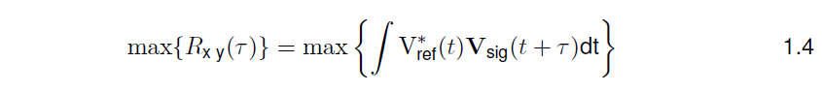
Magnetic Field Computations

Slide 33
Error Sources in the Magnetic Flow Cytometer

Slide 34
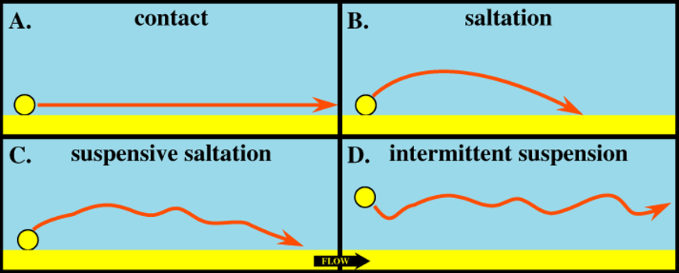
Affinity-dependent Bead Velocity
Magnetically measured bead velocity of biotinlyated bead is statistically higher
Probably attributed to a saltatory movement after adhesion to the channel (B,C)
After adhesion, a wake forms behind the bead thus causes increasing pressure on the back

Slide 35
Comparison of Empirically Determined Correction Factors

Slide 36
Error Sources Affinity-Dependent Concentration Measurement
Inital 100 µl:
magnetophoretic structures are filled
Steep rise
After 700µl:
Surface is saturated with biotinylated beads
Burst-Like Measurement of beads
After 800µl:
Empty Syringe and Sedimentation Effects play a role
➔ Less beads than expected are measured

Slide 37
Hysteresis Calibration of the Sensor

Slide 38
Ocean Nanotech MNPs

Slide 39
Micromod BNF-Dextran

Slide 40
Assessment of Physisorbed Biofunctionalization
Platereader Experiment with AlOx and SiN surfaces
Coverage with fluorescent streptavidin
Washing by 200 µl of buffer with a micropipette
No stability over multiple washing steps
SiN superior to AlOx

Slide 41
Anti-Biotin-PE Assessment

Slide 42
Fluorescent Evaluation of the Biofunctionalization

Slide 43
Surface Activation with Plasma
Difference to Piranha not measrurable in contact angle, but in functionalization operation

Slide 44
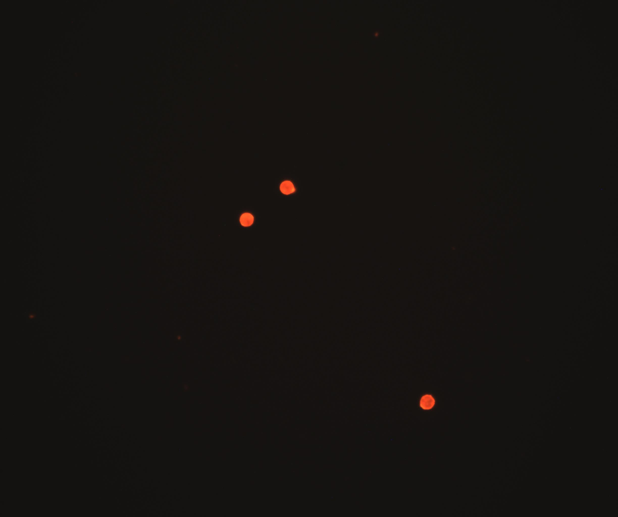
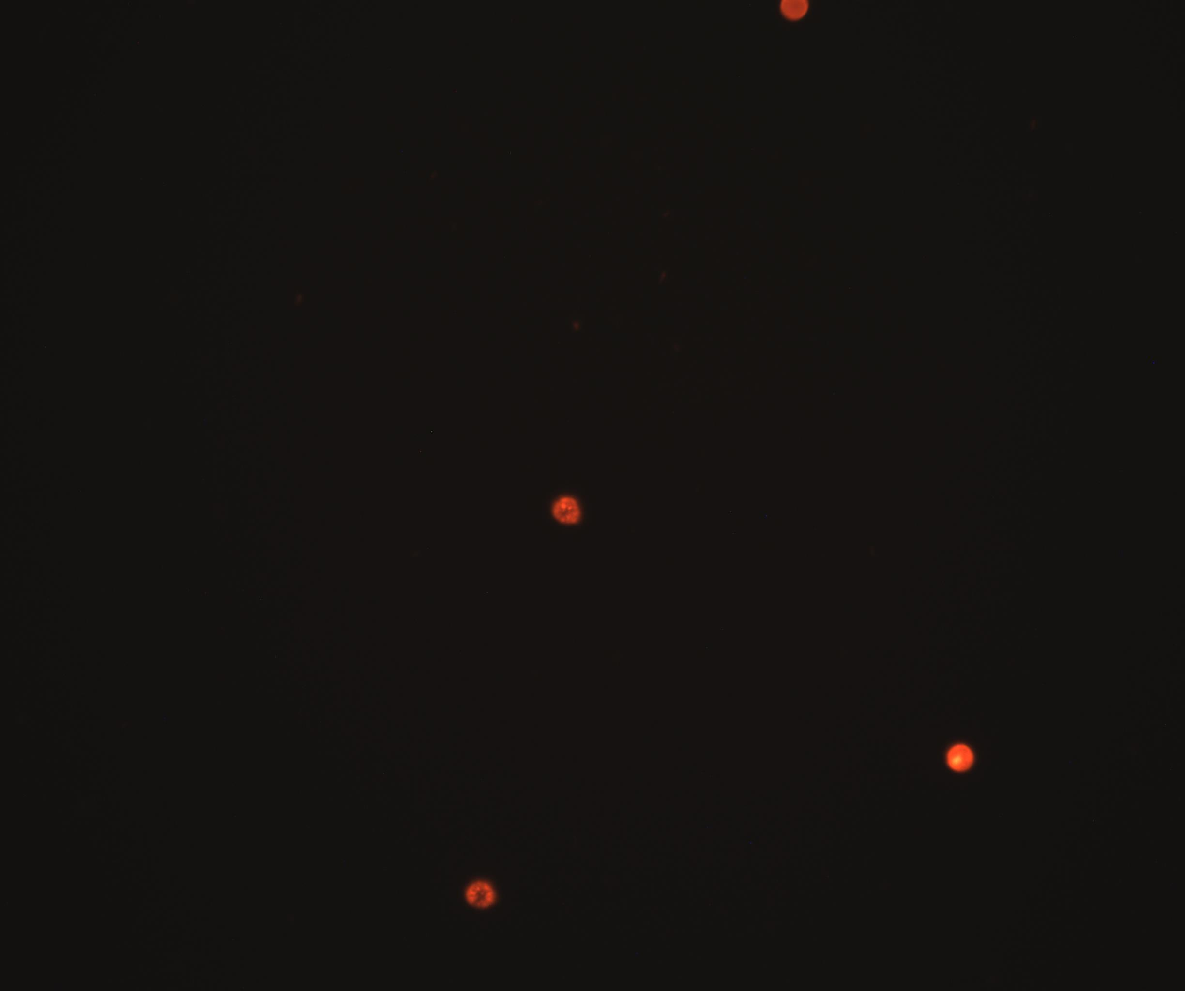
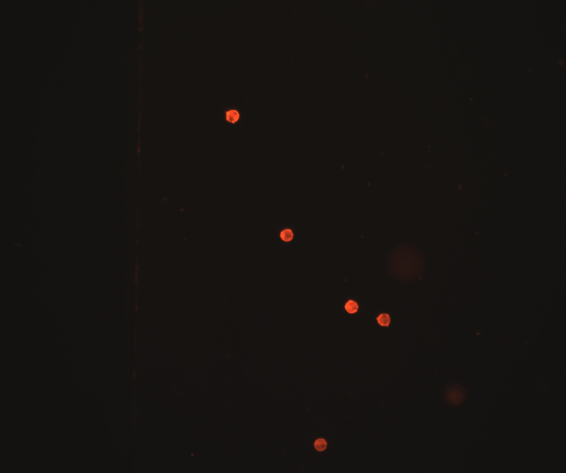
8µm Beads coated with streptavidin-redF-Dextran
Maximum Biotin Coverage
Approx 16% Coverage
Blank

Slide 45
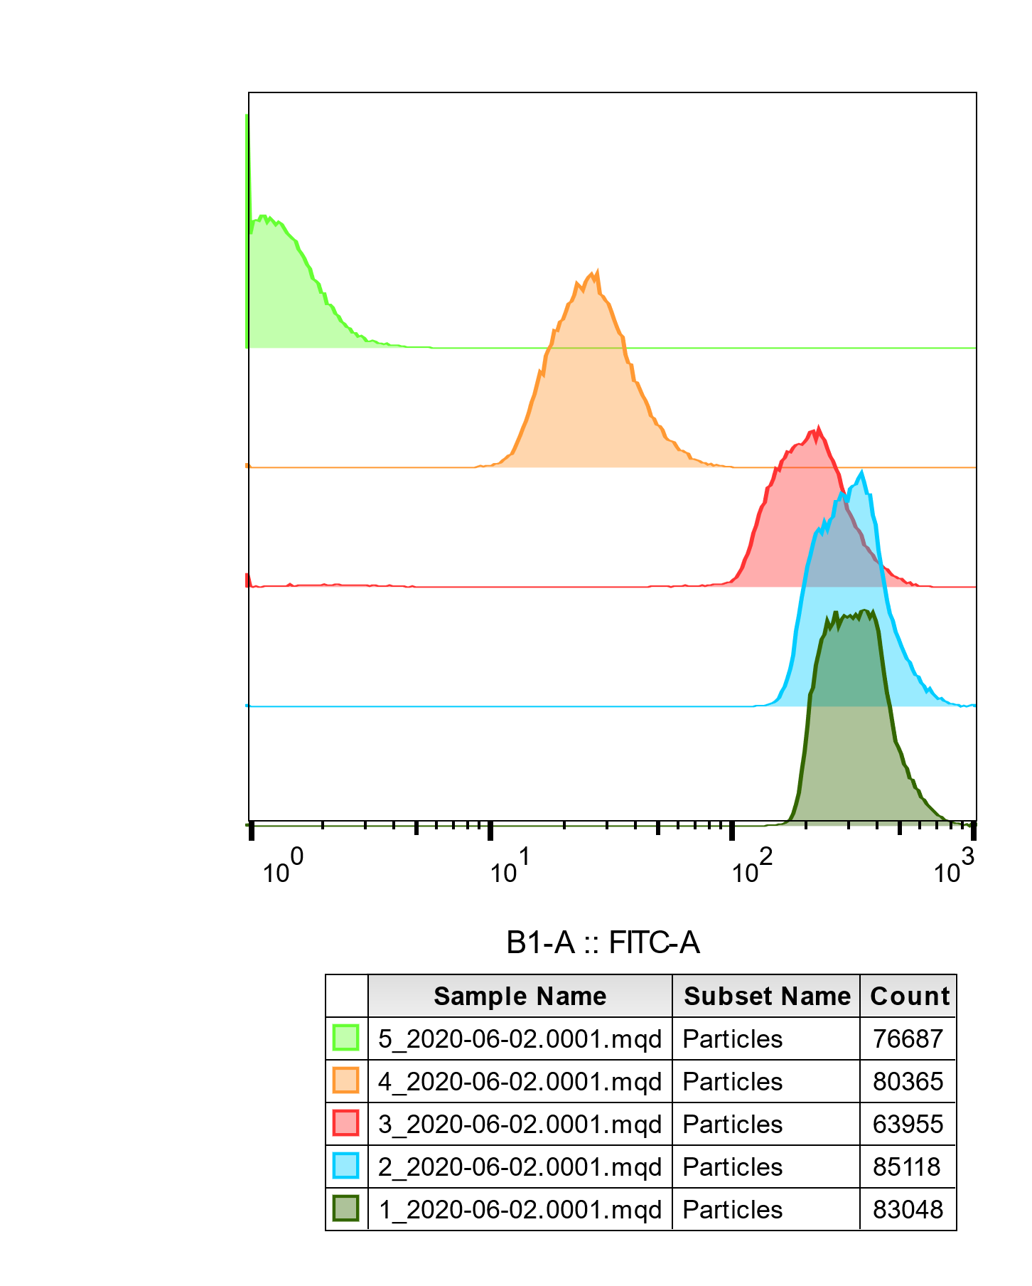

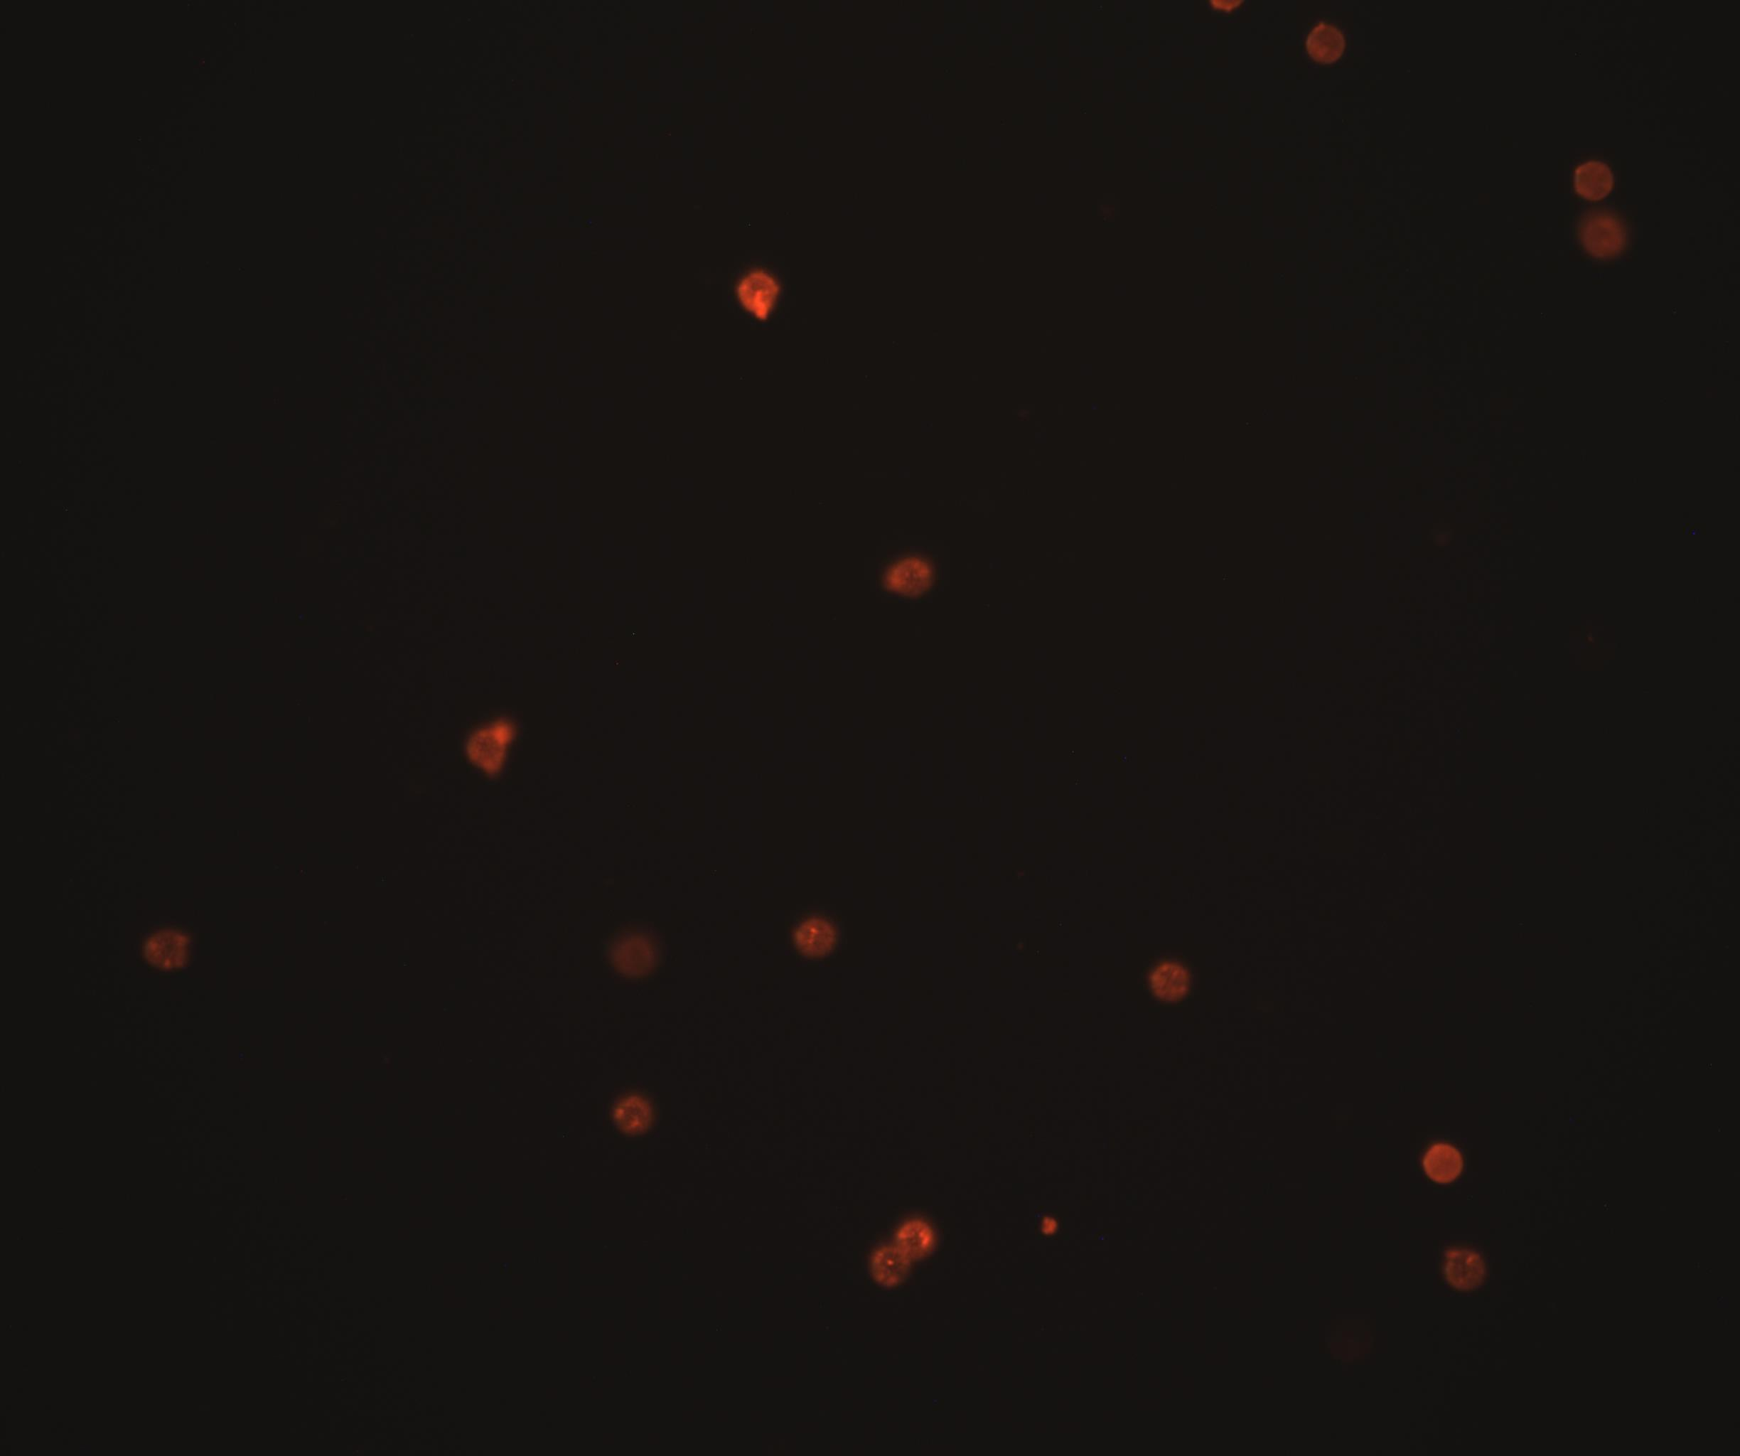


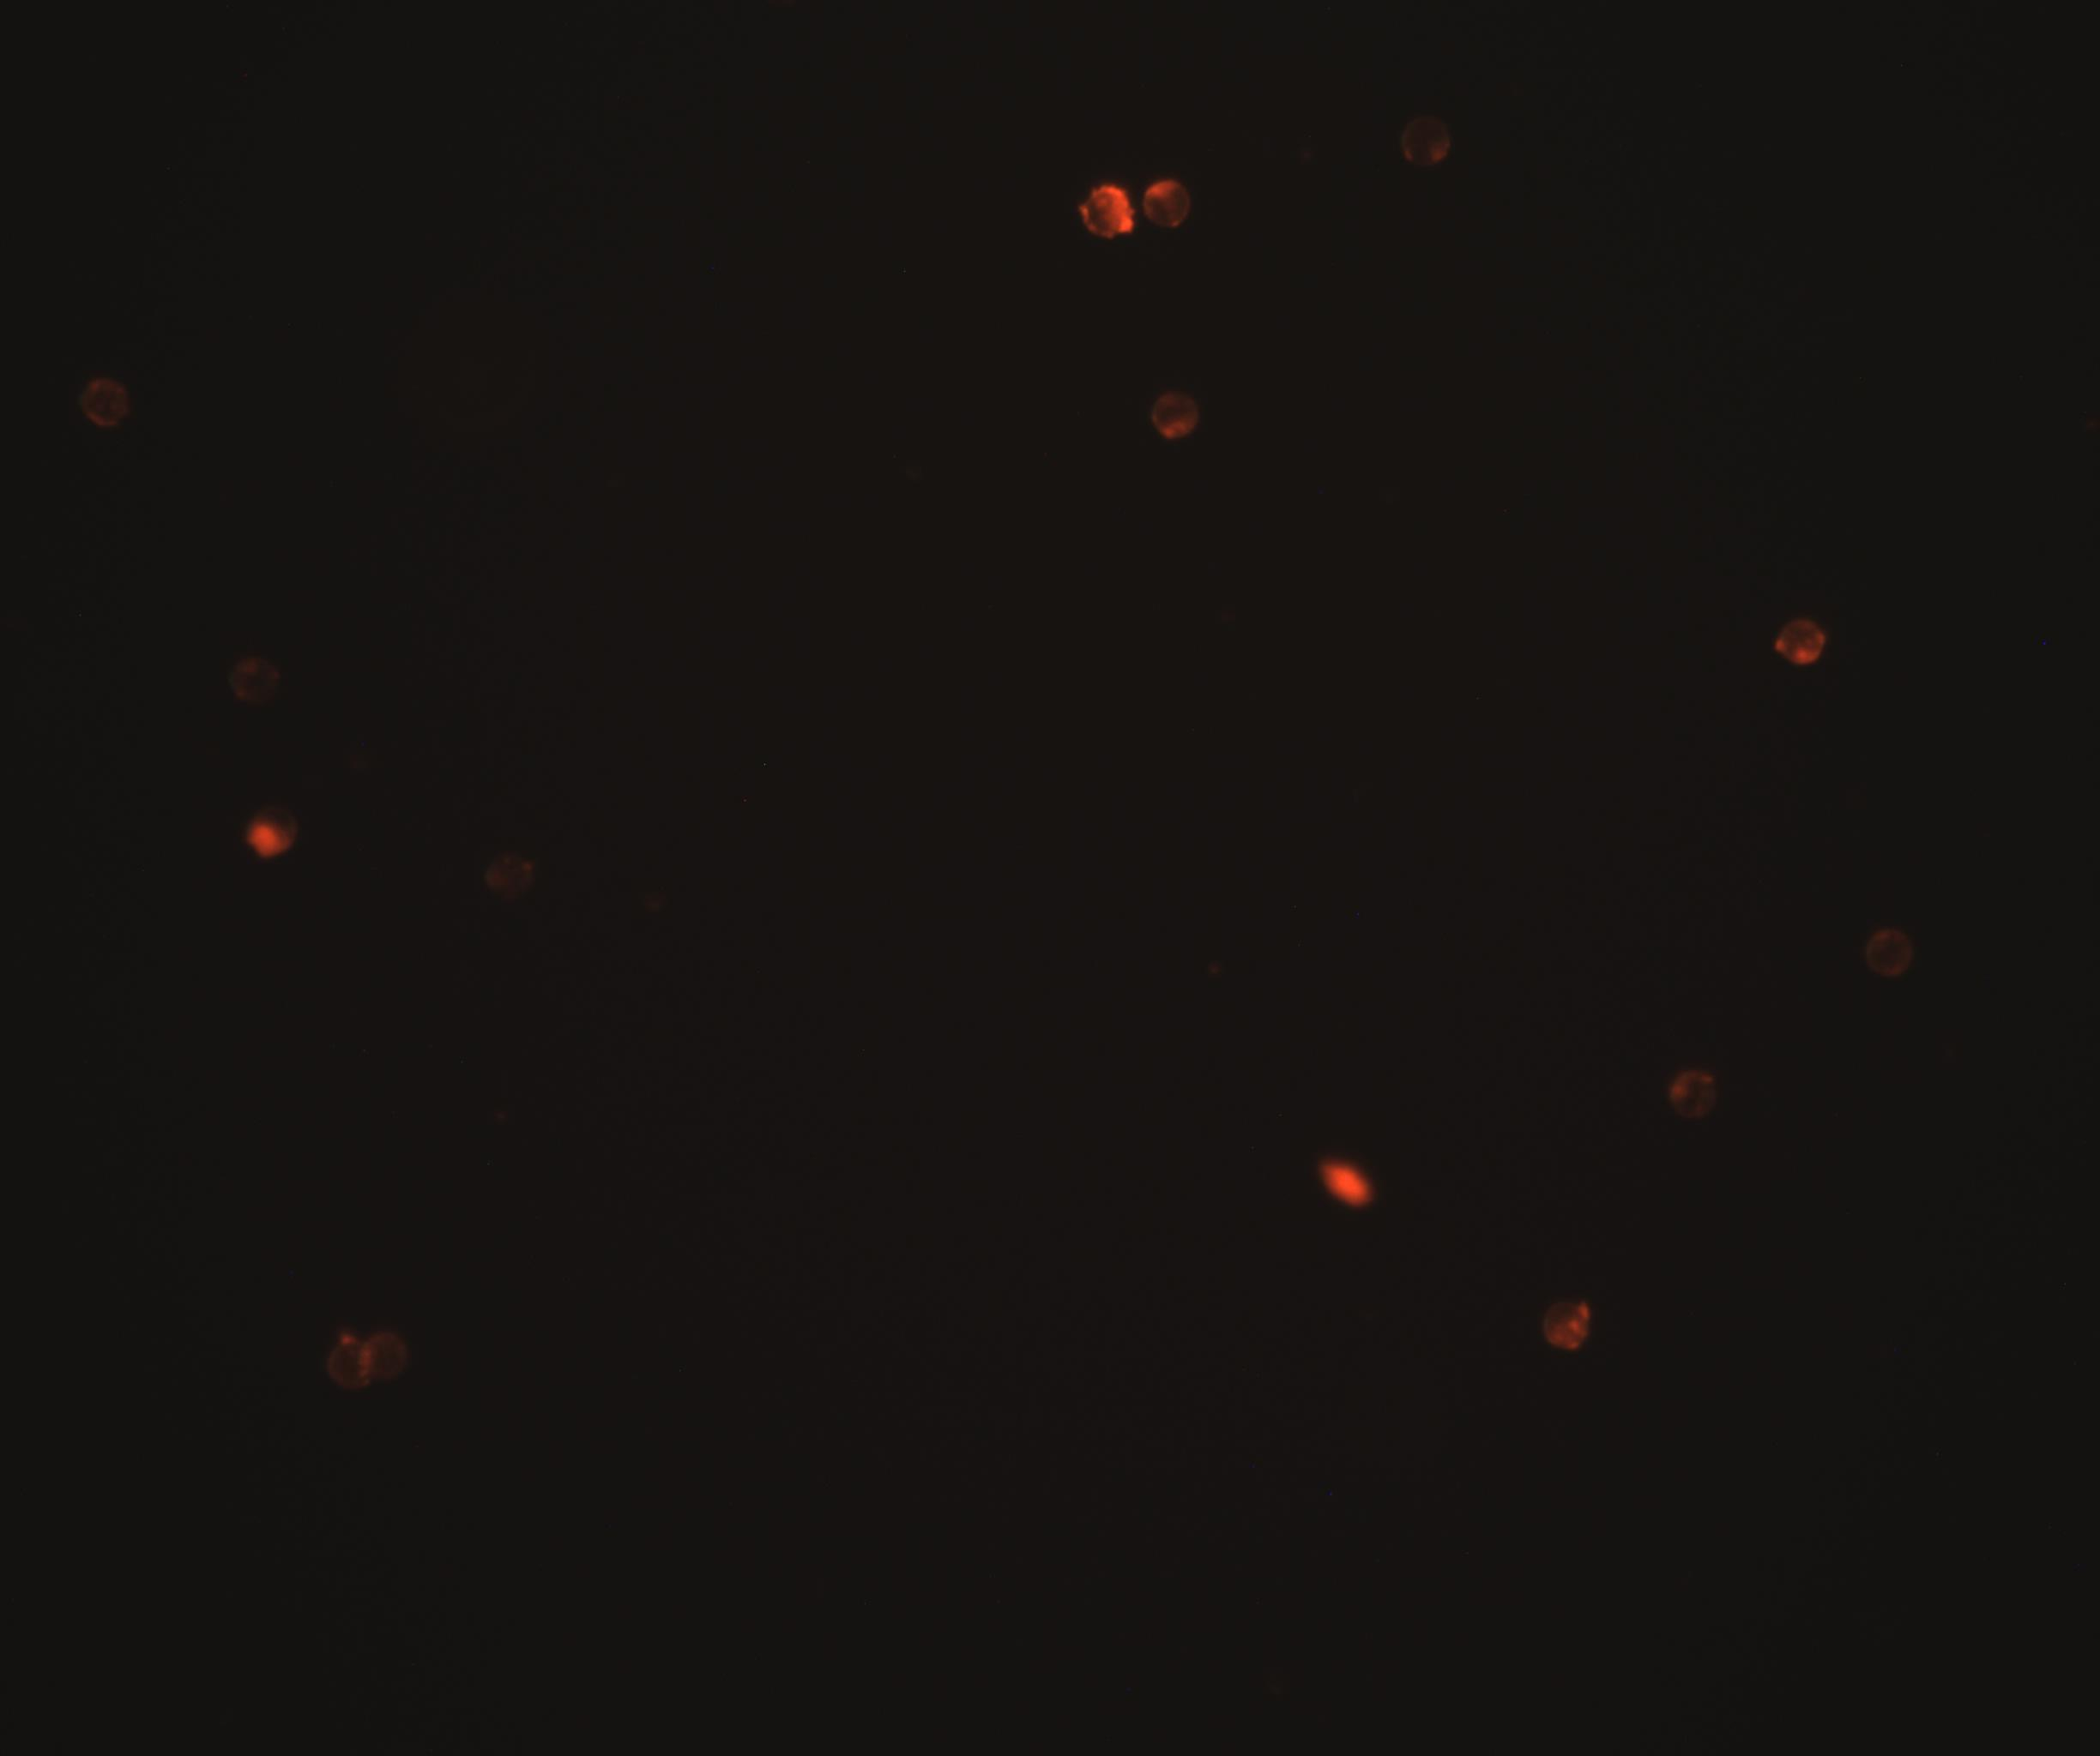

02.06. Biotinylation non-magnetic 8µm
Biotinylated, non-magnetic 8µm Polystyrol
Label: Streptavidin Atto-488
MES
TRIS
TAE
High
(1,dark green in FACS)
µ=52, $\sqrt{\text{σ}}$=11
µ=70, $\sqrt{\text{σ}}$=14
µ=42, $\sqrt{\text{σ}}$=19
Blank
(5,light green in FACS)
µ=40, $\sqrt{\text{σ}}$=9
µ=54, $\sqrt{\text{σ}}$=16
µ=24, $\sqrt{\text{σ}}$=0

Slide 46
Wafer - Spincoating
17.07 3“ SU8-3050 @ 3000 rpm written same day
23.07 3“ SU8-3050 @ 3000 rpm written after one week
27.07 3“ SU8-3050 @ 3000 rpm written same day
29.07 3“ SU8-3025 @ 3000 rpm written two days after
4“ desired 150µm Layer
~ 98 µm
~ 94 µm
~ 53 µm
~ 44 µm
~ 115µm
Water Desorption 120min@160°C
Cool to RT
3ml SU8 (1ml/inch Wafer diameter)
Softbake 1min@65°C 15min@95°C(50µm) 10min@95°C(25µm)
Laser writing / Flood exposure
Spincoat 5s@500rpm(100rpm/s) 30s@3000rpm(300rpm/s)
Clean with Aceton 30s@7000rpm
Post-Exposure-Bake 1min@65°C 5°C@95°C
Develop mrDev 600 6-10min with shaking Optionally: in sonication Bath
Cool to RT

Slide 47
Wafer – Laserwriting
Parameter | Value
Spot size | 0.01 mm
Overlap | 80%
Modulation | 100%
Z-Position | -6.782
velocity | 40 mm/s (omitted lines in dialog)

